Slide 1
How to Improve Our Company’s Attrition Rate
Through data analysis

Slide 2
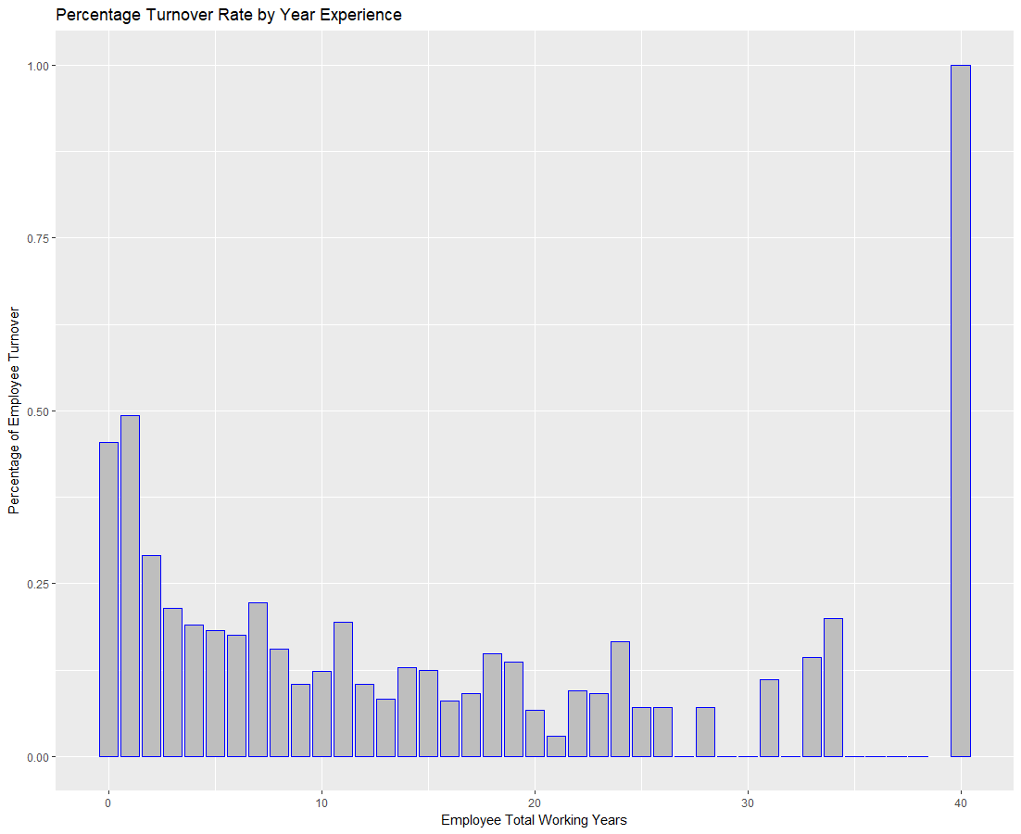
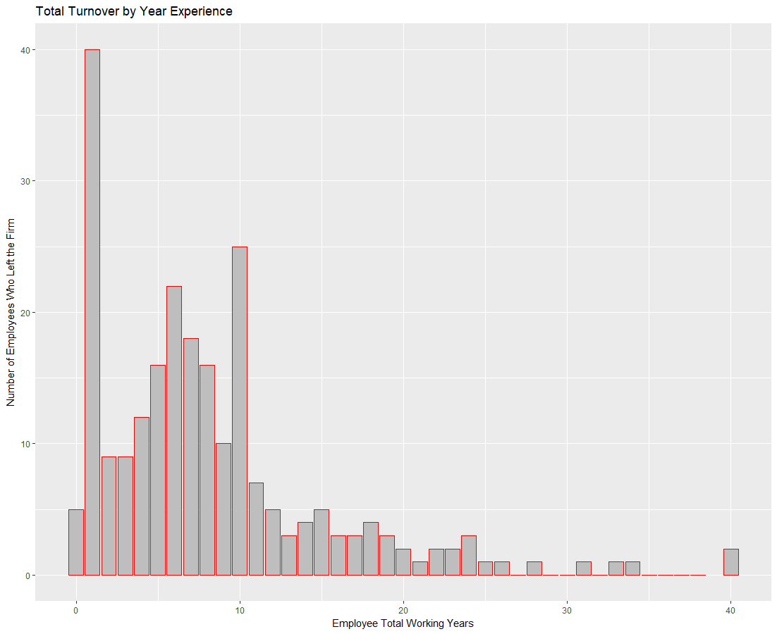

Slide 3
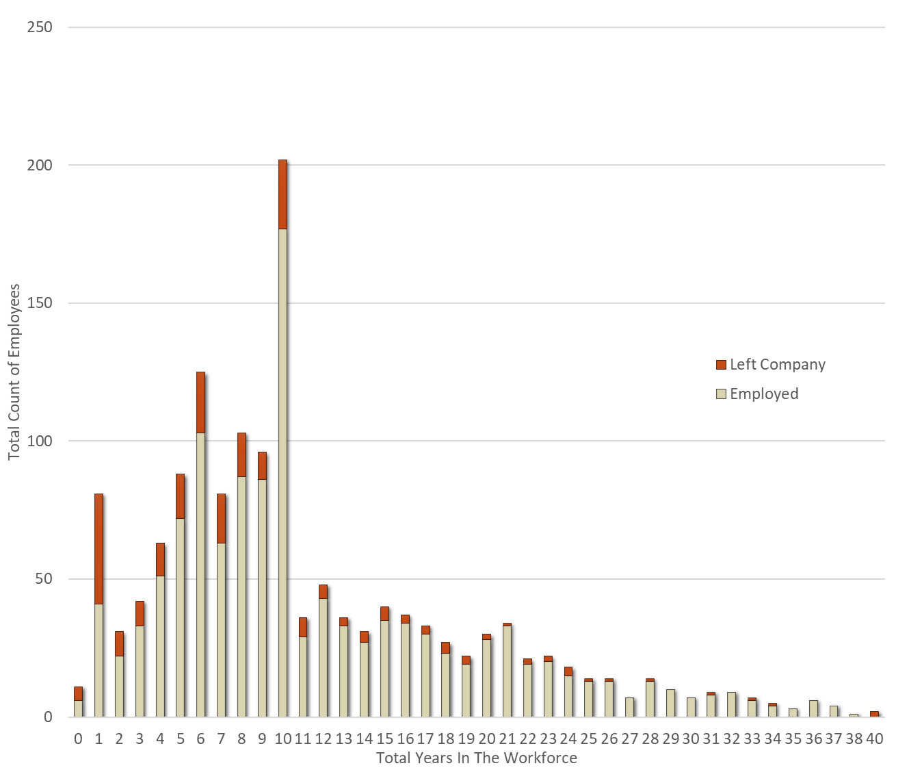
Employees Total Working Years and When They Left
An overall view of our employee base.
Our attrition rates are around 50% for employees under 2 years experience but this is expected.
The attrition rate is also expectedly low for those later in their career.
We are concerned with those between 2 and 11 years of experience.

Slide 4
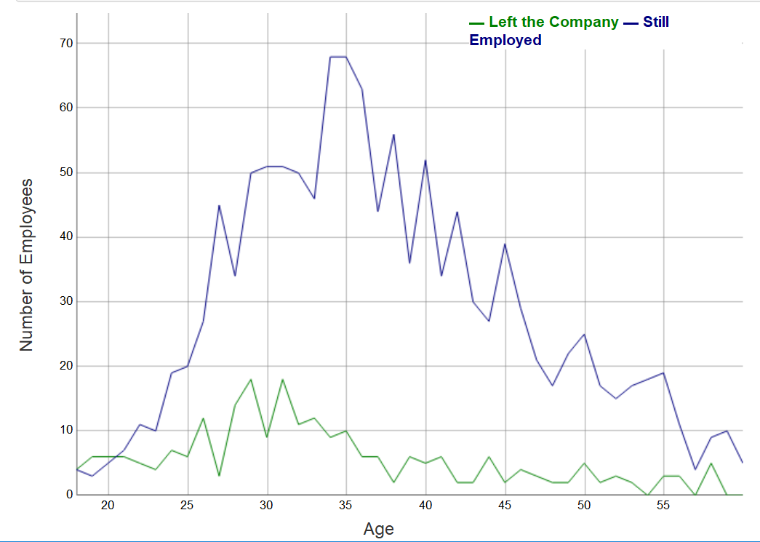
Attrition by Age
Attrition spikes between the ages of 26 and 35.
The 26 to 35 age group represents 41.22% of our total employee base.
86.73% of our employees are between the ages of 24 and 51.
We want to hold onto as many of these employees as possible especially since these are their most productive years in the workforce.

Slide 5
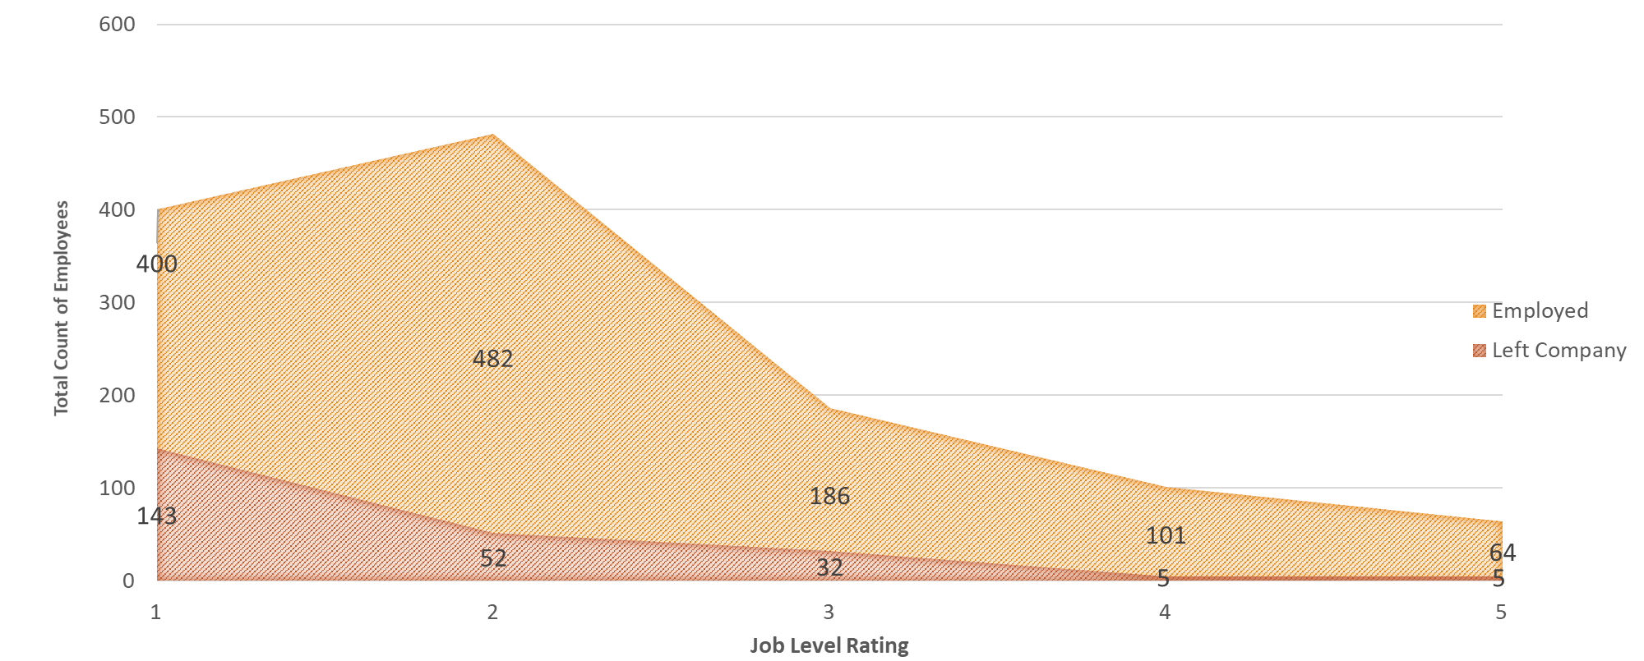
Who Left or Stayed vs Job Satisfaction Survey
Those with entry level jobs and lower titles leave at a very high rate.
Whereas those who we have in leadership and management positions have stayed with the company.
We should promote those who are the best employees as quickly as possible for the best chance to hold onto them.

Slide 6
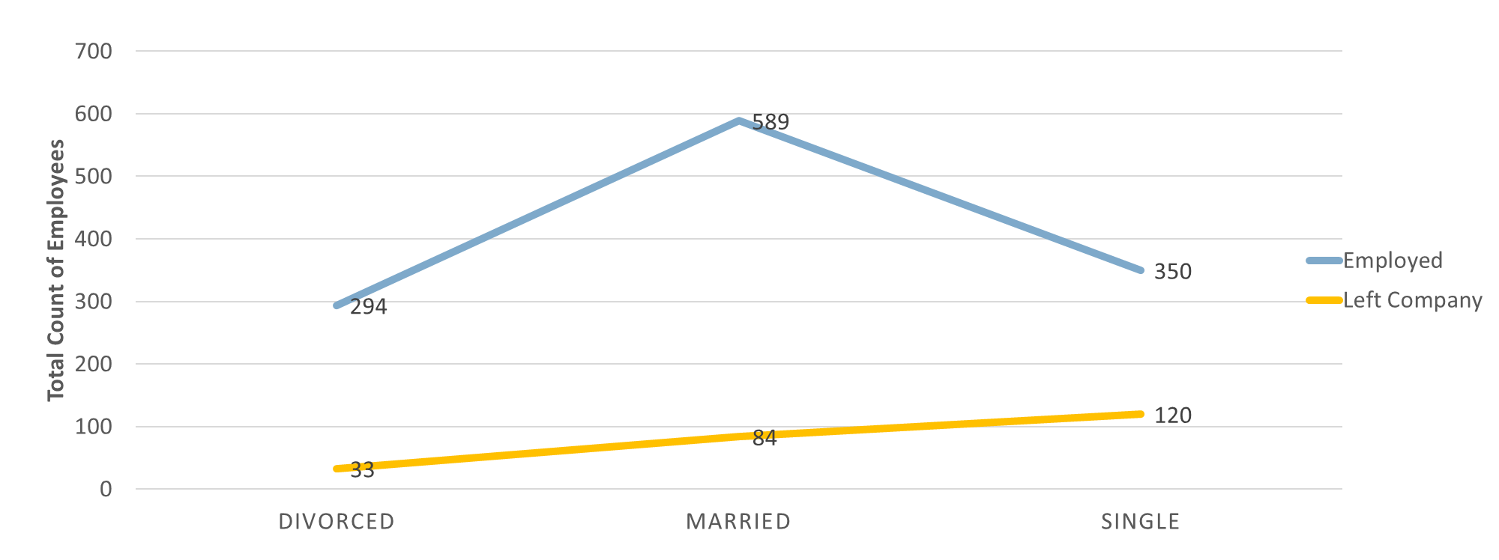
Turnover by Marital Status
Those Divorced and Married have very low attrition rates but those Single have incredibly high turnover.
This is obviously out of our control but a data point we can use to identify chance of leaving.

Slide 7
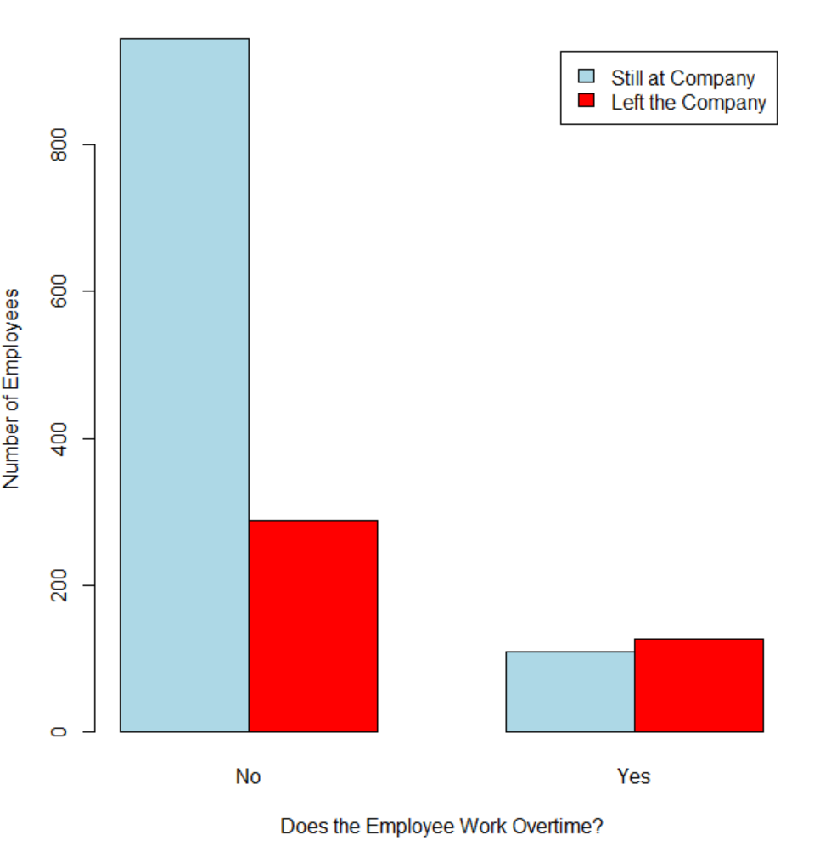
Unhappiness Regarding Overtime
As the chart to the right shows, those employees who work overtime are likely to leave.
We will explore further if this can be explained further by job level and compensation.

